Slide 1


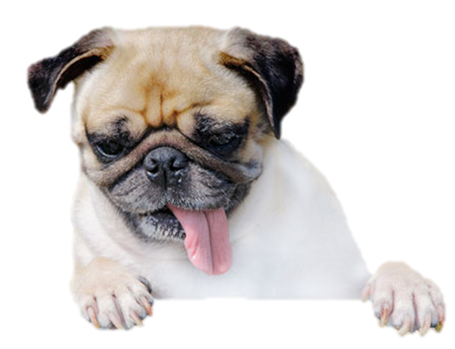
Project
A technological solution to
take care of your friend from far away

Slide 2
Outline
How to take care of our pets who stay at home when we are away?
We created a strategic alliance with our partners Kinship, August and InterSystems to bring to life GeoPet H+
GeoPet H+ is a technological solution to take care of our pet friends at home when we cannot be there.

Slide 3
The Problem
Our pets who stay at home have to stay either inside the house or outside in the yard.
If our pets stays indoors it is complicated for them to do their basic needs, they also might play around and make mischief.
if our pets stays in the yard, they will be exposed to the weather and other factors.

Slide 4
Problem statement
There is a real need to take care of our pets when we leave them alone at home and to be able to interact with them remotely.
Pets are alone for most of the working hours of a day.

Slide 5
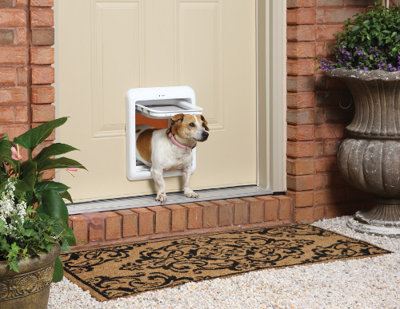
What customers do today
Currently people just choose to either leaver their pets inside or outside.
Others install a traditional doggy door.
Both solutions have several disadvantages such as:
Pets do their needs inside
Pets exposed to bad weather
Other animals can enter through traditional doggy door, even burglars.
If pet runs away, there is no way to know.

Slide 6
Solution Proposal
Innovative solution

Slide 7
Why it’s better than existing solutions
Return to the problem now that you’ve introduced your solution. Compare your solution to others and describe how it is superior.

Slide 8
Wireframes

Slide 9
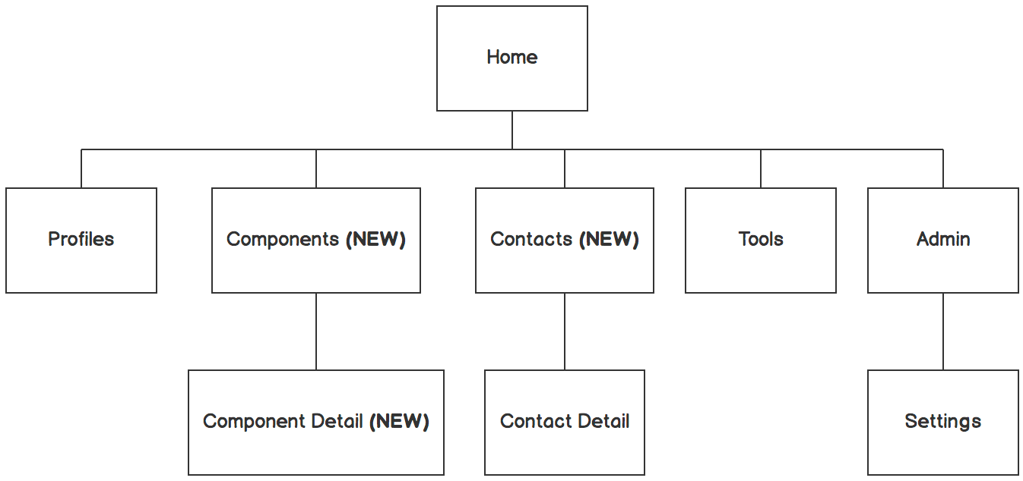

Information architecture
Balsamiq Tip | Information architecture is the flow of content across the site or application (more info).

Slide 10
Next Steps

Slide 11
What next?
Present the timeline.
Solicit comments on these slides or reviews on these wireframes in the Balsamiq add-on.
User testing plan.

Slide 12
Questions?

Slide 13
References
Tips for Presenting Your Wireframes
3 Steps to Better UI Wireframes
Wireframing for Beginners

